Slide 1
Fourier series Representation of Discrete-time Periodic Signals

Slide 2
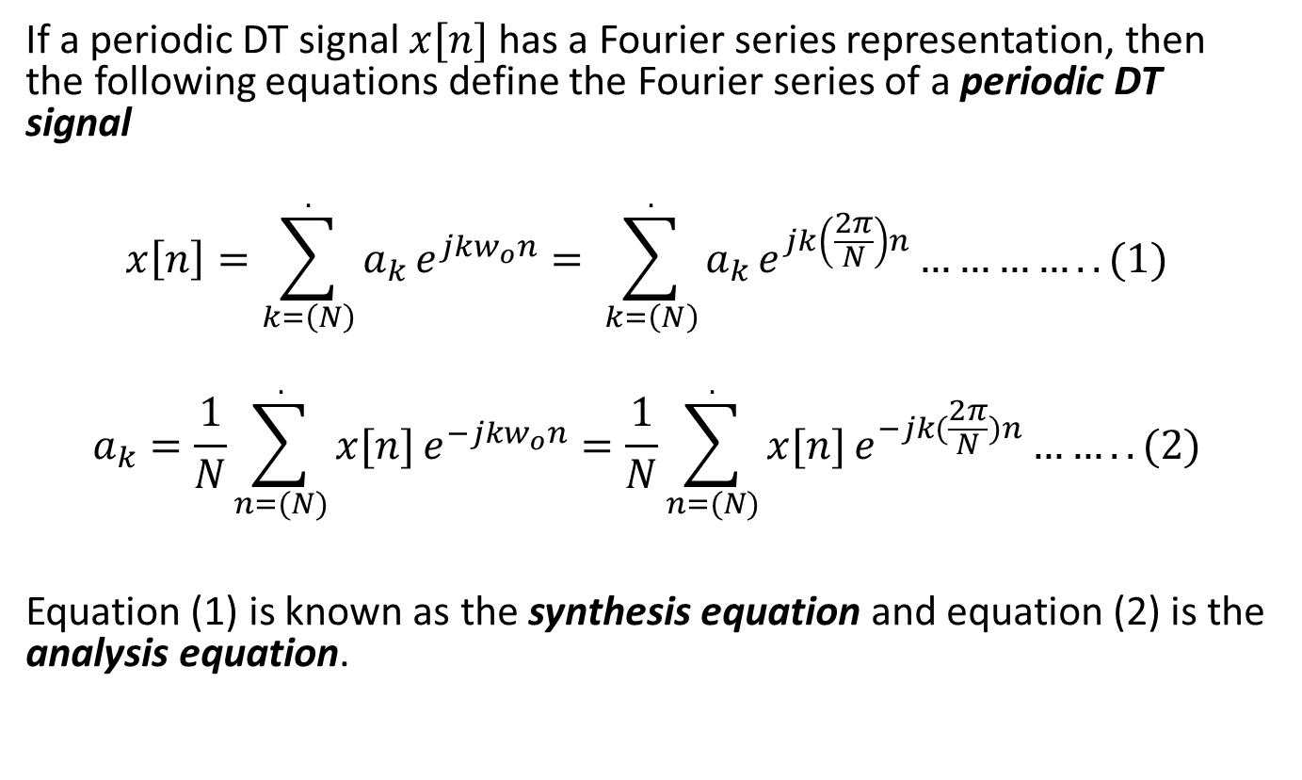
If a periodic DT signal $x[n]$ has a Fourier series representation, then the following equations define the Fourier series of a periodic DT signal
$$x\left[n\right]=\sum_{k=\left(N\right)}^{.}{a_{k}}e^{jkw_{o}n}= \sum_{k=\left(N\right)}^{.}{a_{k}}e^{jk\left(\frac{2π}{N}\right)n}…………..(1)$$
$$a_{k}=\frac{1}{N}\sum_{n=(N)}^{.}{x[n]}e^{−jkw_{o}n}=\frac{1}{N}\sum_{n=(N)}^{.}{x[n]}e^{−jk(\frac{2π}{N})n}……..(2)$$
Equation (1) is known as the synthesis equation and equation (2) is the analysis equation.

Slide 3
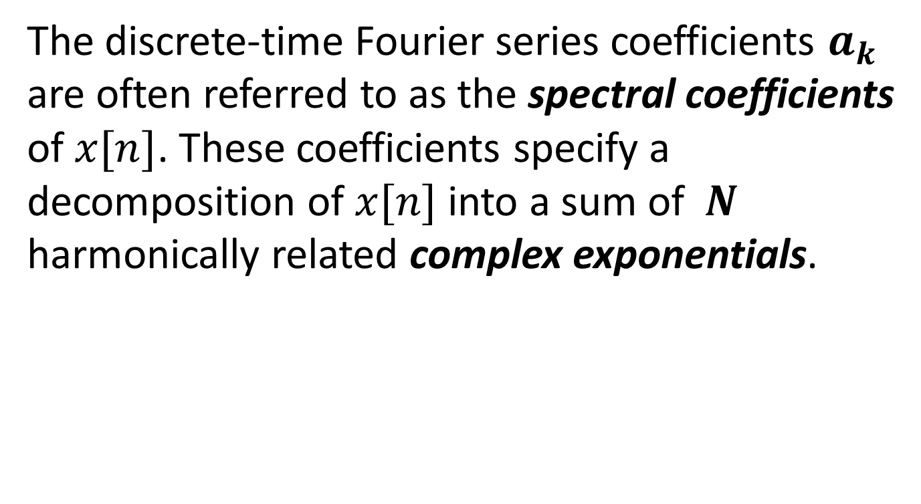
The discrete-time Fourier series coefficients $a_{k}$ are often referred to as the spectral coefficients of $x[n]$. These coefficients specify a decomposition of $x[n]$ into a sum of $N$ harmonically related complex exponentials.

Slide 4
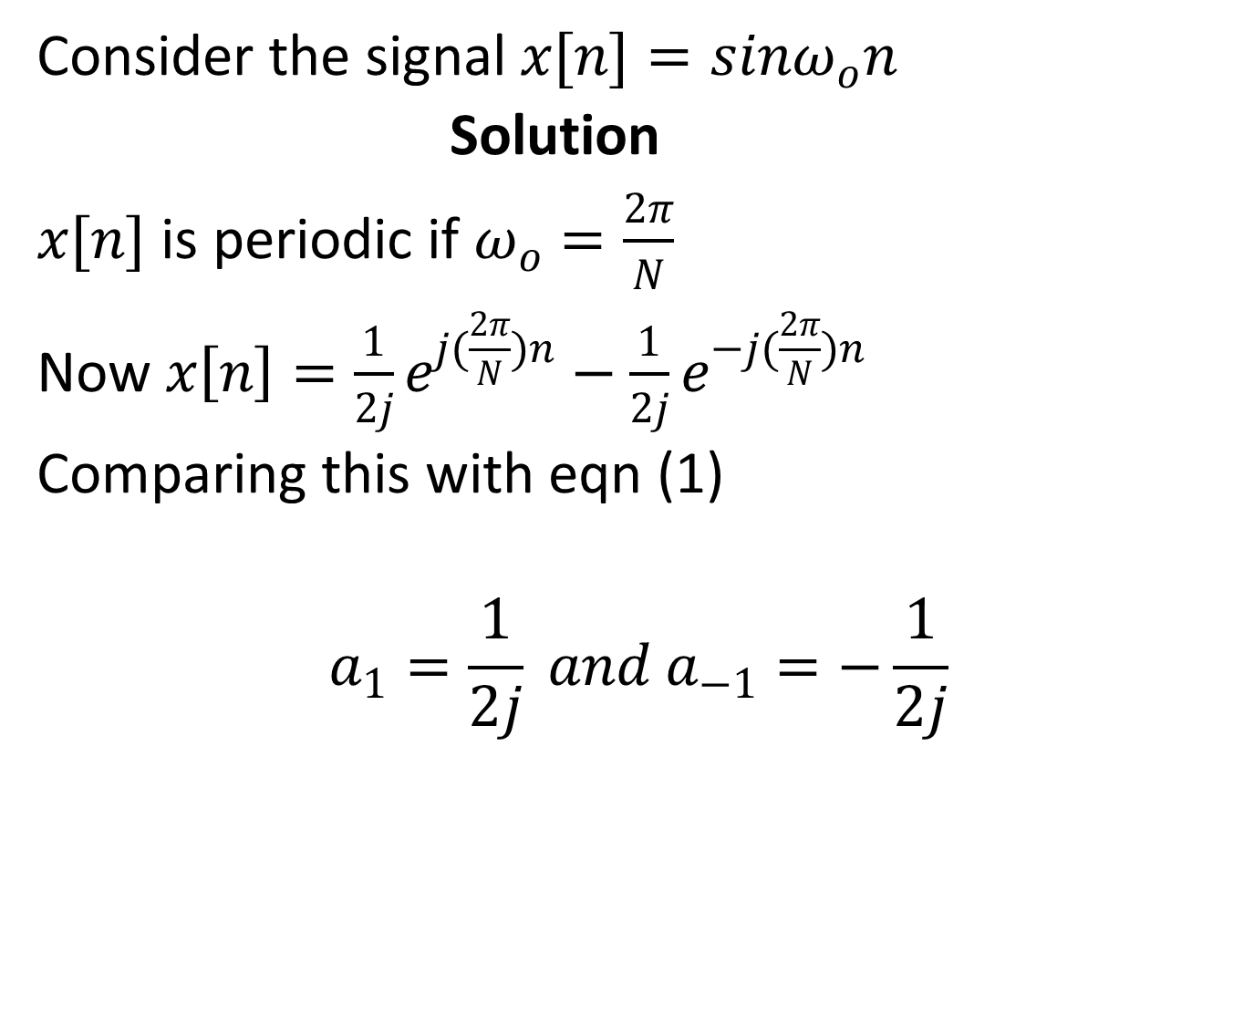
Example
Consider the signal $x[n]=sinω_{o}n$
Solution
$x[n]$ is periodic if $ω_{o}=\frac{2π}{N}$
Now $x\left[n\right]=\frac{1}{2j}e^{j(\frac{2π}{N})n}−\frac{1}{2j}e^{−j(\frac{2π}{N})n}$
Comparing this with eqn (1)
$$a_{1}=\frac{1}{2j} and a_{−1}=−\frac{1}{2j}$$

Slide 5
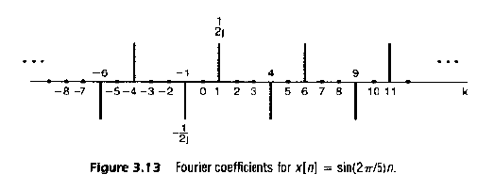

And the remaining coefficients over the interval of summation are zero.
These coefficients repeat with period $N$.For example if $N=5$ we get the illustration below.

Slide 6
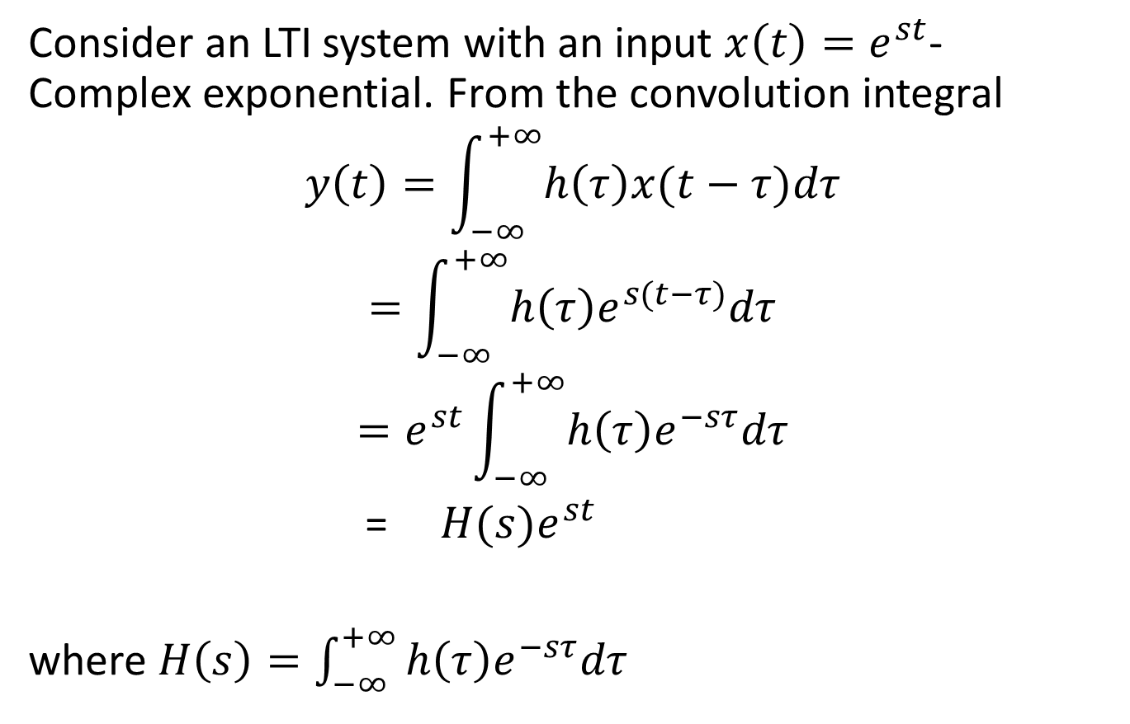
FOURIER SERIES AND LTI SYSTEMS
Consider an LTI system with an input $x\left(t\right)=e^{st}$- Complex exponential. From the convolution integral
$$y\left(t\right)=\int_{−∞}^{+∞}{h\left(τ\right)x(t−τ)dτ}$$
$$=\int_{−∞}^{+∞}{h\left(τ\right)e^{s(t−τ)}dτ}$$
$$=e^{st}\int_{−∞}^{+∞}{h\left(τ\right)e^{−sτ}dτ}$$
=$H(s)e^{st}$
where $H\left(s\right)=\int_{−∞}^{+∞}{h\left(τ\right)e^{−sτ}dτ}$

Slide 7
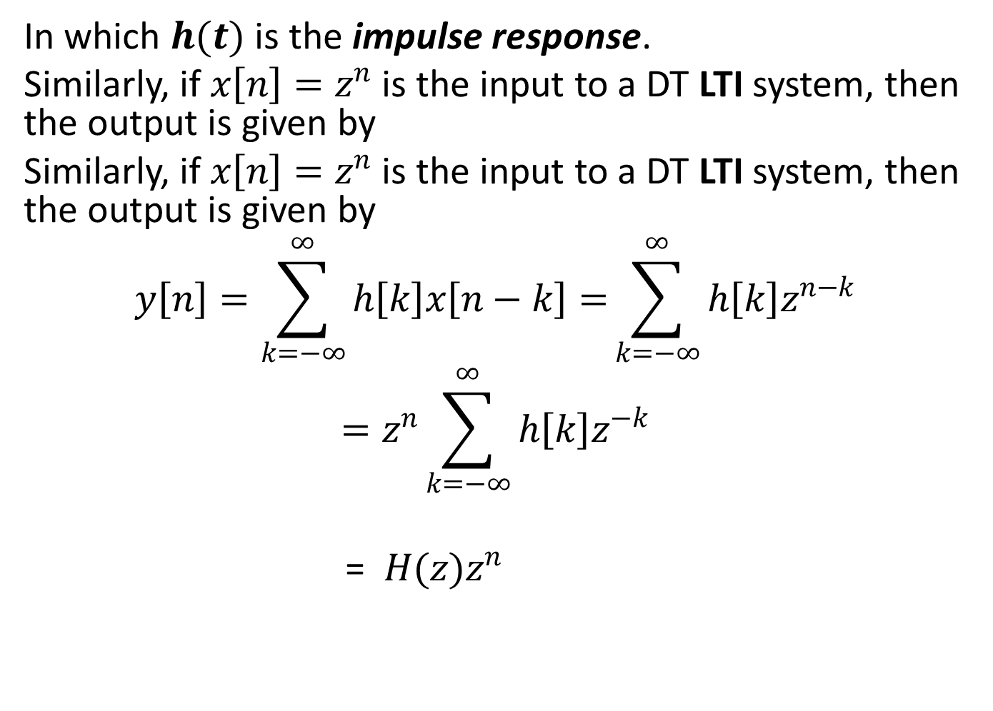
In which $h(t)$ is the impulse response.
Similarly, if $x\left[n\right]=z^{n}$ is the input to a DT LTI system, then the output is given by
Similarly, if $x\left[n\right]=z^{n}$ is the input to a DT LTI system, then the output is given by
$$y\left[n\right]=\sum_{k=−∞}^{∞}{h\left[k\right]x\left[n−k\right]=}\sum_{k=−∞}^{∞}{h\left[k\right]z^{n−k}}$$
$$=z^{n}\sum_{k=−∞}^{∞}{h\left[k\right]z^{−k}}$$
= $H(z)z^{n}$

Slide 8
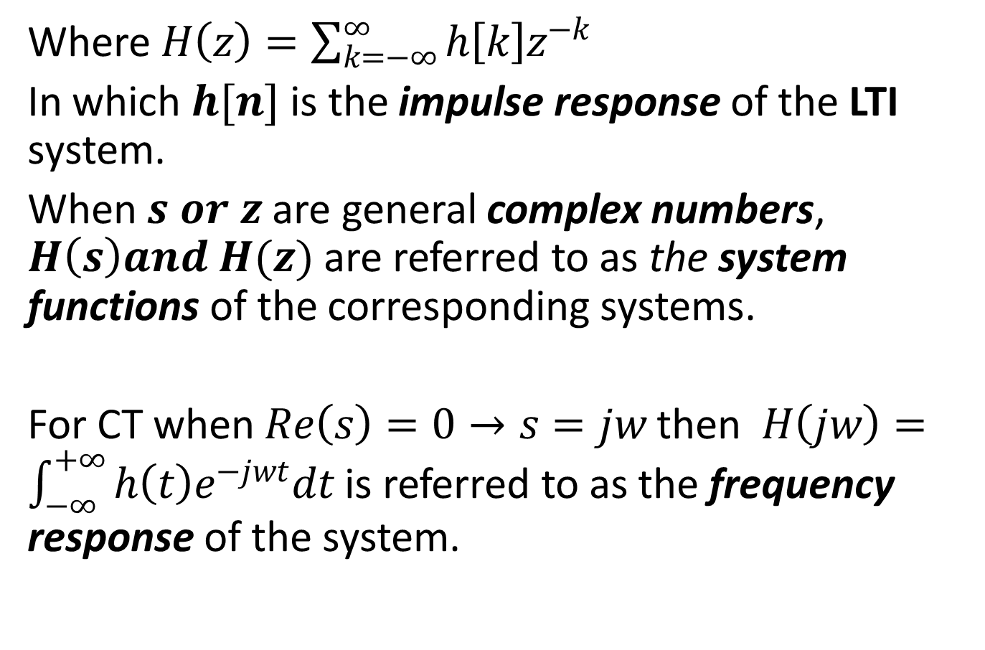
Where $H\left(z\right)=\sum_{k=−∞}^{∞}{h\left[k\right]z^{−k}}$
In which $h[n]$ is the impulse response of the LTI system.
When $s or z$ are general complex numbers, $H\left(s\right)and H(z)$ are referred to as the system functions of the corresponding systems.
For CT when $Re\left(s\right)=0→s=jw$ then $H\left(jw\right)=\int_{−∞}^{+∞}{h\left(t\right)e^{−jwt}dt}$ is referred to as the frequency response of the system.

Slide 9
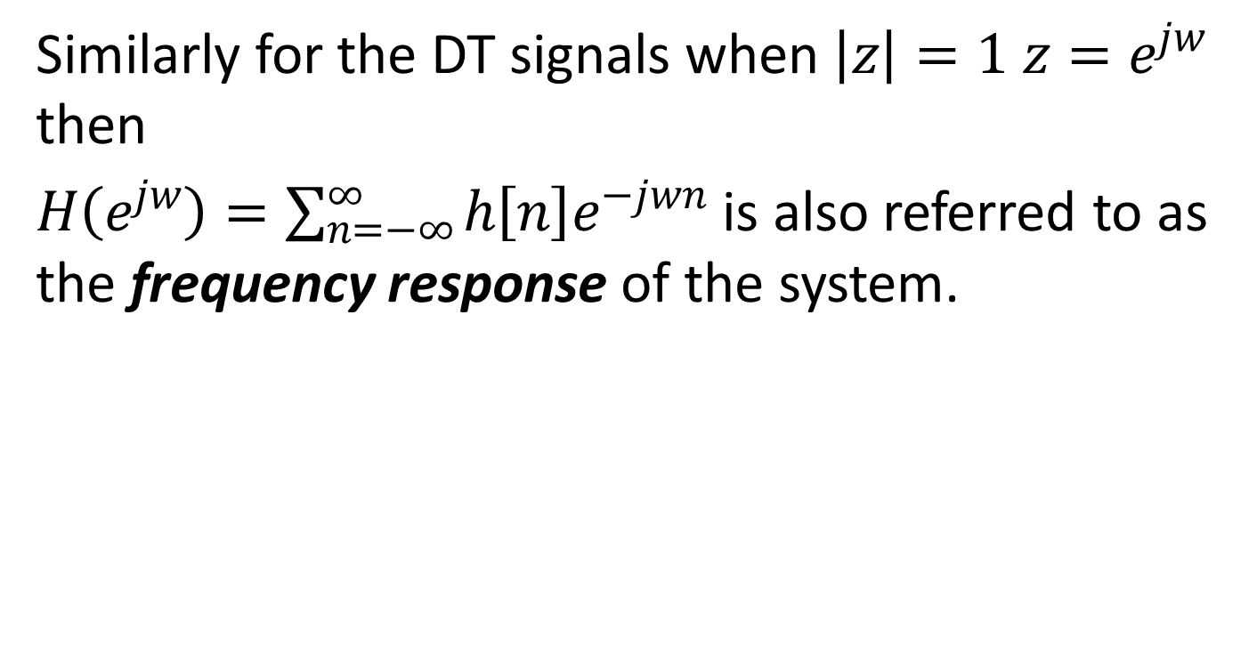
Similarly for the DT signals when $\left|z\right|=1$ $z=e^{jw}$ then
$H\left(e^{jw}\right)=\sum_{n=−∞}^{∞}{h\left[n\right]e^{−jwn}}$ is also referred to as the frequency response of the system.

